Slide 1
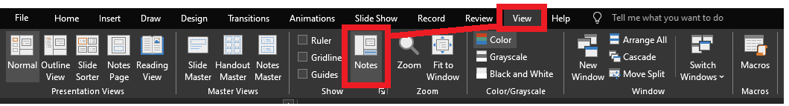
Reviewing after the presentation?
Be sure to enable the Notes for slide-specific content

Slide 2

LIKE, to the max!

Slide 3
stringable1 LIKE stringable2
SELECT [name], [description]
FROM [SomeTable]
WHERE [description] LIKE ...
“Stringable” refers to anything that can be represented as a string, including numerics, datetimes, guids, etc.

Slide 4
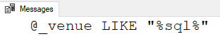
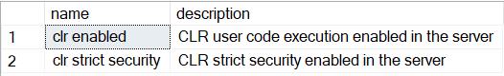
stringable1 LIKE stringable2
DECLARE @_venue varchar(20)
= 'SQL Saturday 20XX'
IF @_venue LIKE '%sql%'
PRINT '@_venue LIKE "%sql%"'
“Stringable” refers to anything that can be represented as a string, including numerics, datetimes, guids, etc.
Stringable1 is usually the longer string
Stringable2 is usually the shorter string with one/more % symbols as wildcards
Returns boolean
SELECT [name], [description]
FROM master.sys.configurations
WHERE [description] LIKE 'clr%'

Slide 5
% – Wildcard of any length (even zero)
WHERE Column1 LIKE '%' -- returns all non-NULL values
WHERE Column1 LIKE 'A%' -- returns values starting with A
WHERE Column1 LIKE '%A' -- returns values ending with A
WHERE Column1 LIKE 'A%B' -- returns values starting with A
and ending with B
WHERE Column1 LIKE '%B%' -- returns values containing B

Slide 6

%

Slide 7

_
[]
[-]
[^]
%
ESCAPE

Slide 8

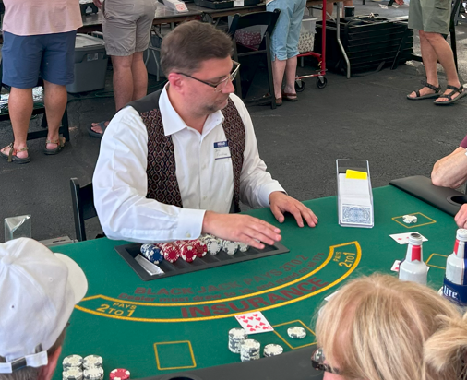



Jeff Foushee
SQL Server Database Admin
Programmer
SQL Saturday speaker
Blackjack dealer
https://www.linkedin.com/in/jeff-foushee/
https://github.com/jbfoushee/MyPresentations/

Slide 9
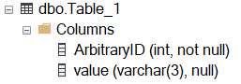
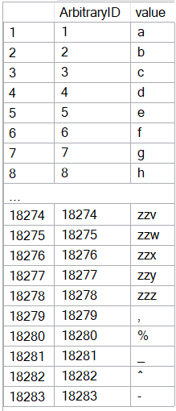
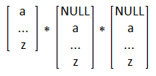
CREATE TABLE dbo.Table_1
( ArbitraryID int IDENTITY(1,1) NOT NULL, [value] varchar(3) )
SET NOCOUNT ON
DECLARE @_text2 varchar(26) = 'abcdefghijklmnopqrstuvwxyz'
DECLARE @_text1 varchar(26) = @_text2
DECLARE @_text0 varchar(26) = @_text1
DECLARE @_p2 tinyint = 0
DECLARE @_p1 tinyint = 0
DECLARE @_p0 tinyint = 0
WHILE 1 = 1
BEGIN
SET @_p2 +=1
IF @_p2 > 26
BEGIN
SET @_p1 += 1
SET @_p2 = 1
END
IF @_p1 > 26
BEGIN
SET @_p0 += 1
SET @_p1 = 1
END
IF @_p0 > 26
BREAK
DECLARE @_text varchar(3) = CONCAT(
SUBSTRING(@_text0, @_p0, 1)
, SUBSTRING(@_text1, @_p1, 1)
, SUBSTRING(@_text2, @_p2, 1) )
INSERT INTO dbo.Table_1 (value) VALUES (@_text)
END
INSERT INTO [dbo].[Table_1] ([value]) VALUES(','), ('%'), ('_'), ('^'), ('-')
INSERT INTO [dbo].[Table_1] ([value]) VALUES(','), ('%'), ('_'), ('^'), ('-')
Notes:
This code will build the sample data used for the demos

Slide 10
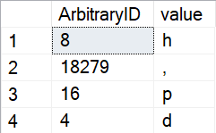
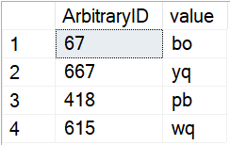
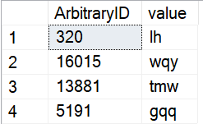
_ – Wildcard of one character (i.e. non-zero length)
SELECT TOP 4 *
FROM dbo.Table_1
WHERE Column1 LIKE '_'
ORDER BY NEWID() -- randomizer
SELECT TOP 4 *
FROM dbo.Table_1
WHERE Column1 LIKE '__'
ORDER BY NEWID() -- randomizer
SELECT TOP 4 *
FROM dbo.Table_1
WHERE Column1 LIKE '__%'
ORDER BY NEWID() -- randomizer
Notes:
The underscore guarantees a length of one character per underscore requested.

Slide 11
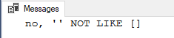
[] – Containment characters
By themselves do nothing
DECLARE @_value varchar(20) = ''
IF @_value LIKE '[]'
PRINT 'yes, '''' LIKE []'
ELSE
PRINT 'no, '''' NOT LIKE []'

Slide 12
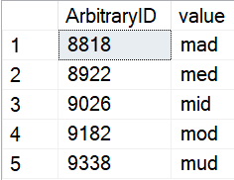
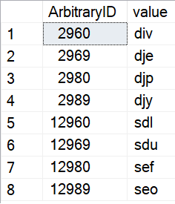
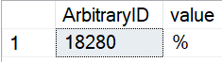
[] – Containment characters
Represent a non-delimited array of allowable characters as one position
% and _ lose their special wildcard ability inside the containment characters
NULL/blank are not acceptable entries for this list
WHERE [value] LIKE 'm[aeiou]d'
WHERE ArbitraryID LIKE '%[2%]9[86][90]'
WHERE [value] LIKE '[%]'

Slide 13
Do I need to worry about case-sensitivity?

Slide 14
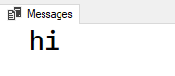
Do I need to worry about case-sensitivity?
No functions, not even UPPER() and LOWER() are case-sensitive
IF UPPER('a') = 'a'
PRINT 'hi'

Slide 15
Do I need to worry about case-sensitivity?
No functions, not even UPPER() and LOWER() are case-sensitive
Do you need to follow/enforce something other than the current collation?

Slide 16
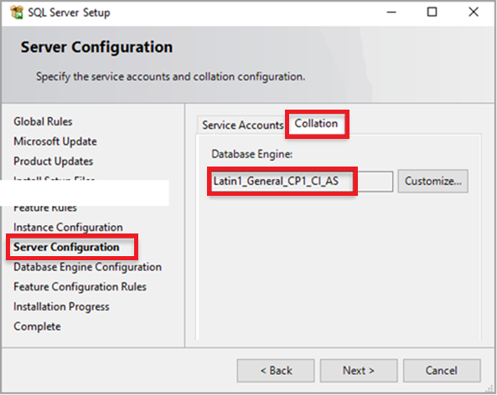
The Collation (Case-Sensitivity) Hierarchy
Instance – What was set when SQL Server was first installed?
SELECT SERVERPROPERTY('collation')

Slide 17
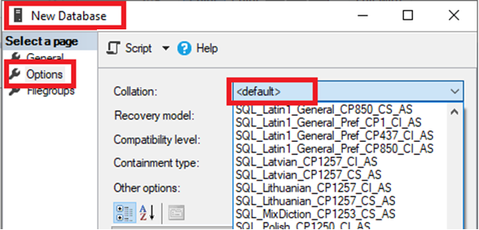
The Collation (Case-Sensitivity) Hierarchy
Instance – What was set when SQL Server was first installed?
Database – Default or explicit?
IF 'A' = 'a'
PRINT 'Case-insensitive database'
ELSE
PRINT 'Case-sensitive database'
SELECT [name], collation_name
FROM sys.databases
WHERE name = DB_NAME()
SELECT DB_NAME(), DATABASEPROPERTYEX(DB_NAME(), 'collation')

Slide 18
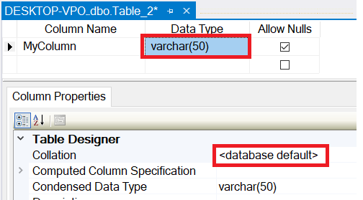
The Collation (Case-Sensitivity) Hierarchy
Instance – What was set when SQL Server was first installed?
Database – Default or explicit?
Table Column – Database default or explicit?
SELECT TABLE_SCHEMA, TABLE_NAME, COLUMN_NAME
, DATA_TYPE
, COLLATION_NAME
, CASE Convert(varchar,IsNull(COLLATION_NAME, ''))
WHEN '' THEN ''
WHEN Convert(varchar, DATABASEPROPERTYEX(DB_NAME(), 'collation')) THEN ''
ELSE '*'
END AS Not_As_DB_Collation
FROM INFORMATION_SCHEMA.COLUMNS
ORDER BY TABLE_SCHEMA, TABLE_NAME, COLUMN_NAME

Slide 19
The Collation (Case-Sensitivity) Hierarchy
Instance – What was set when SQL Server was first installed?
FROM Table_1 t1
INNER JOIN Table_2 t2
ON t1.SomeColumn
COLLATE
SQL_Latin1_General_CP1_CI_AS
= t2.SomeColumn
Database – Default or explicit?
FROM Table_1 t1
INNER JOIN Table_2 t2
ON t1.SomeColumn = t2.SomeColumn
Table Column – Database default or explicit?
Cannot resolve the collation conflict between "SQL_Latin1_General_CP1_CI_AS" and "Latin1_General_CI_AS" in the equal to operation.
Query-level – temporarily treat it differently for calculation purposes

Slide 20
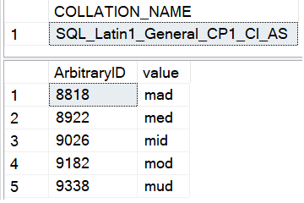
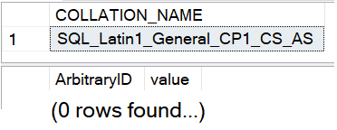
Is LIKE case-sensitive?
No functions, not even UPPER() and LOWER() are case-sensitive
Do you need to follow/enforce something other than the current collation?
-- Request column collation
SELECT isc.COLLATION_NAME
FROM INFORMATION_SCHEMA.COLUMNS isc
WHERE isc.TABLE_NAME = 'Table_1'
AND isc.COLUMN_NAME = 'value'
-- Original query results in CAPS
SELECT t1.ArbitraryID, t1.[value]
FROM Table_1 t1
WHERE t1.[value] LIKE 'M[AEIOU]D'

Slide 21
What if I need to worry about case-sensitivity?
No functions, not even UPPER() and LOWER() are case-sensitive
Do you need to follow/enforce something other than the current collation?
Forcing case-sensitivity on an case-insensitive column:
WHERE [CI_value] COLLATE Latin1_General_CS_AS LIKE 'm[aeiou]d'
Forcing case-insensitivity on an case-sensitive column:
WHERE [CS_value] COLLATE Latin1_General_CI_AS LIKE 'm[aeiou]d'
WHERE [CS_value] LIKE '[mM][aAeEiIoOuU][dD]'
WHERE LOWER([CS_value]) LIKE 'm[aeiou]d'
Notes:
If you plan to use these types of queries often, you might consider building a persisted computed column to speed up finding these results. You can index a computed column.

Slide 22
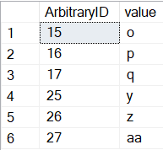
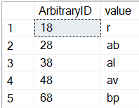
[-] – Range character
Provides a shortcut to consolidate characters on its immediate left and right
Characters must be contiguous. Lower value must be on the left.
WHERE [ArbitraryID] LIKE '[1-2][5-7]'
WHERE [ArbitraryID] LIKE '[1-46]8'
1 5
2 6
7
1
2
3 8
4
6

Slide 23
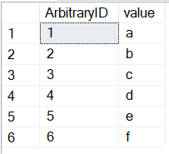
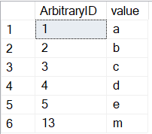
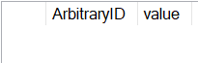
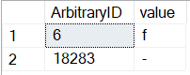
[-] – Range character
Provides a shortcut to consolidate characters on its immediate left and right
Characters must be contiguous. Lower value must be on the left.
WHERE [value] LIKE '[a-f]'
WHERE [value] LIKE '[a-em]'
WHERE [value] LIKE '[f-a]'
WHERE [value] LIKE '[-f]'

Slide 24
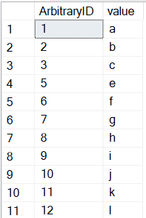
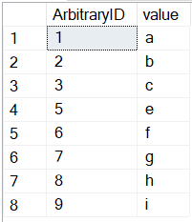

[^] – Negation character
Provides a “NOT” to all characters on its right
Must be the FIRST character within the containment characters to take effect
WHERE [ArbitraryID] LIKE '[^4]'
WHERE [ArbitraryID] NOT LIKE '[4]'

Slide 25
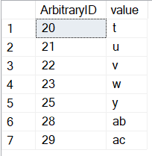
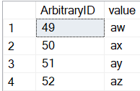
[^] – Negation character
Must be the FIRST character within the containment characters to take effect
Provides a “NOT” to all characters on its right
WHERE [ArbitraryID] LIKE '2[^467]'
WHERE [value] LIKE 'a[^a-v]''

Slide 26
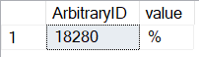
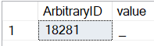
ESCAPE stringable
WHERE [value] LIKE '%\%%' ESCAPE '\'
WHERE [value] LIKE '%!_%' ESCAPE '!'

Slide 27
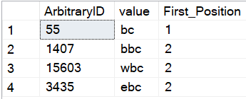
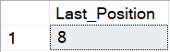
PATINDEX(like_pattern, stringable)
Returns the starting position of the first occurrence of a pattern in a specified expression, or zero if the pattern is not found, on all valid text and character data types.
SELECT TOP 4 ArbitraryID
, [value]
, PATINDEX('%bc', [value]) AS [First_Position]
FROM dbo.Table_1
WHERE [value] LIKE '%bc'
ORDER BY NEWID()
--Find the "last position" using REVERSE()
DECLARE @_value varchar(20) = 'abcdefabcg'
SELECT LEN(@_value)
- PATINDEX(REVERSE('%bc%'), REVERSE(@_value))
AS [Last_Position]

Slide 28
On the horizon, true RegEx…
https://devblogs.microsoft.com/azure-sql/introducing-regular-expression-regex-support-in-azure-sql-db/
Function | Description
REGEXP_LIKE() | This function returns TRUE if a string matches a regular expression pattern, or FALSE otherwise
REGEXP_COUNT() | This function returns the number of times a regular expression pattern matches in a string
REGEXP_INSTR() | This function returns the starting or ending position, based on the specified option, of the given occurrence of a regular expression pattern in a string.
REGEXP_REPLACE() | This function returns a substring that matches a regular expression pattern from a string.
REGEXP_SUBSTR() | This function returns a modified string replaced by a ‘replacement string’, where occurrence of the regular expression pattern found.

Slide 29
Should I switch to RegEx?
Is what I have in the LIKE statement good enough?
Do I understand RegEx well enough to write in it?
Do I understand all the business rules well enough to write it in RegEx?
Could others on the team support my RegEx?
Can I steal a RegEx pattern from the Internet? Does the Internet agree on a pattern?

Slide 30



WHERE Email LIKE '%@%.%'
WHERE REGEXP_LIKE
(Email,'^[A-Za-z0-9._%+-]+@[A-Za-z0-9.-]+\.[A-Za-z]{2,}$')

Slide 31
Mail::RFC822::Address: RegExp-based address validation
(?:(?:\r\n)?[ \t])*(?:(?:(?:[^()<>@,;:\\".\[\] \000-\031]+(?:(?:(?:\r\n)?[ \t])+|\Z|(?=[\["()<>@,;:\\".\[\]]))|"(?:[^\"\r\\]|\\.|(?:(?:\r\n)?[ \t]))*"(?:(?:\r\n)?[ \t])*)(?:\.(?:(?:\r\n)?[ \t])*(?:[^()<>@,;:\\".\[\] \000-\031]+(?:(?:(?:\r\n)?[ \t])+|\Z|(?=[\["()<>@,;:\\".\[\]]))|"(?:[^\"\r\\]|\\.|(?:(?:\r\n)?[\t]))*"(?:(?:\r\n)?[ \t])*))*@(?:(?:\r\n)?[ \t])*(?:[^()<>@,;:\\".\[\] \000-\031]+(?:(?:(?:\r\n)?[ \t])+|\Z|(?=[\["()<>@,;:\\".\[\]]))|\[([^\[\]\r\\]|\\.)*\](?:(?:\r\n)?[ \t])*)(?:\.(?:(?:\r\n)?[ \t])*(?:[^()<>@,;:\\".\[\] \000-\031]+(?:(?:(?:\r\n)?[ \t])+|\Z|(?=[\["()<>@,;:\\".\[\]]))|\[([^\[\]\r\\]|\\.)*\](?:(?:\r\n)?[ \t])*))*|(?:[^()<>@,;:\\".\[\] \000-\031]+(?:(?:(?:\r\n)?[ \t])+|\Z|(?=[\["()<>@,;:\\".\[\]]))|"(?:[^\"\r\\]|\\.|(?:(?:\r\n)?[ \t]))*"(?:(?:\r\n)?[ \t])*)*\<(?:(?:\r\n)?[ \t])*(?:@(?:[^()<>@,;:\\".\[\] \000-\031]+(?:(?:(?:\r\n)?[ \t])+|\Z|(?=[\["()<>@,;:\\".\[\]]))|\[([^\[\]\r\\]|\\.)*\](?:(?:\r\n)?[ \t])*)(?:\.(?:(?:\r\n)?[ \t])*(?:[^()<>@,;:\\".\[\] \000-\031]+(?:(?:(?:\r\n)?[ \t])+|\Z|(?=[\["()<>@,;:\\".\[\]]))|\[([^\[\]\r\\]|\\.)*\](?:(?:\r\n)?[ \t])*))*(?:,@(?:(?:\r\n)?[ \t])*(?:[^()<>@,;:\\".\[\] \000-\031]+(?:(?:(?:\r\n)?[ \t])+|\Z|(?=[\["()<>@,;:\\".\[\]]))|\[([^\[\]\r\\]|\\.)*\](?:(?:\r\n)?[ \t])*)(?:\.(?:(?:\r\n)?[ \t])*(?:[^()<>@,;:\\".\[\] \000-\031]+(?:(?:(?:\r\n)?[ \t])+|\Z|(?=[\["()<>@,;:\\".\[\]]))|\[([^\[\]\r\\]|\\.)*\](?:(?:\r\n)?[ \t])*))*)*:(?:(?:\r\n)?[ \t])*)?(?:[^()<>@,;:\\".\[\] \000-\031]+(?:(?:(?:\r\n)?[ \t])+|\Z|(?=[\["()<>@,;:\\".\[\]]))|"(?:[^\"\r\\]|\\.|(?:(?:\r\n)?[ \t]))*"(?:(?:\r\n)?[ \t])*)(?:\.(?:(?:\r\n)?[ \t])*(?:[^()<>@,;:\\".\[\] \000-\031]+(?:(?:(?:\r\n)?[ \t])+|\Z|(?=[\["()<>@,;:\\".\[\]]))|"(?:[^\"\r\\]|\\.|(?:(?:\r\n)?[ \t]))*"(?:(?:\r\n)?[ \t])*))*@(?:(?:\r\n)?[ \t])*(?:[^()<>@,;:\\".\[\] \000-\031]+(?:(?:(?:\r\n)?[ \t])+|\Z|(?=[\["()<>@,;:\\".\[\]]))|\[([^\[\]\r\\]|\\.)*\](?:(?:\r\n)?[ \t])*)(?:\.(?:(?:\r\n)?[ \t])*(?:[^()<>@,;:\\".\[\] \000-\031]+(?:(?:(?:\r\n)?[ \t])+|\Z|(?=[\["()<>@,;:\\".\[\]]))|\[([^\[\]\r\\]|\\.)*\](?:(?:\r\n)?[ \t])*))*\>(?:(?:\r\n)?[ \t])*)|(?:[^()<>@,;:\\".\[\] \000-\031]+(?:(?:(?:\r\n)?[ \t])+|\Z|(?=[\["()<>@,;:\\".\[\]]))|"(?:[^\"\r\\]|\\.|(?:(?:\r\n)?[ \t]))*"(?:(?:\r\n)?[ \t])*)*:(?:(?:\r\n)?[ \t])*(?:(?:(?:[^()<>@,;:\\".\[\] \000-\031]+(?:(?:(?:\r\n)?[ \t])+|\Z|(?=[\["()<>@,;:\\".\[\]]))|"(?:[^\"\r\\]|\\.|(?:(?:\r\n)?[ \t]))*"(?:(?:\r\n)?[ \t])*)(?:\.(?:(?:\r\n)?[ \t])*(?:[^()<>@,;:\\".\[\] \000-\031]+(?:(?:(?:\r\n)?[ \t])+|\Z|(?=[\["()<>@,;:\\".\[\]]))|"(?:[^\"\r\\]|\\.|(?:(?:\r\n)?[ \t]))*"(?:(?:\r\n)?[ \t])*))*@(?:(?:\r\n)?[ \t])*(?:[^()<>@,;:\\".\[\] \000-\031]+(?:(?:(?:\r\n)?[ \t])+|\Z|(?=[\["()<>@,;:\\".\[\]]))|\[([^\[\]\r\\]|\\.)*\](?:(?:\r\n)?[ \t])*)(?:\.(?:(?:\r\n)?[ \t])*(?:[^()<>@,;:\\".\[\] \000-\031]+(?:(?:(?:\r\n)?[ \t])+|\Z|(?=[\["()<>@,;:\\".\[\]]))|\[([^\[\]\r\\]|\\.)*\](?:(?:\r\n)?[ \t])*))*|(?:[^()<>@,;:\\".\[\] \000-\031]+(?:(?:(?:\r\n)?[ \t])+|\Z|(?=[\["()<>@,;:\\".\[\]]))|"(?:[^\"\r\\]|\\.|(?:(?:\r\n)?[ \t]))*"(?:(?:\r\n)?[ \t])*)*\<(?:(?:\r\n)?[ \t])*(?:@(?:[^()<>@,;:\\".\[\] \000-\031]+(?:(?:(?:\r\n)?[ \t])+|\Z|(?=[\["()<>@,;:\\".\[\]]))|\[([^\[\]\r\\]|\\.)*\](?:(?:\r\n)?[ \t])*)(?:\.(?:(?:\r\n)?[ \t])*(?:[^()<>@,;:\\".\[\] \000-\031]+(?:(?:(?:\r\n)?[ \t])+|\Z|(?=[\["()<>@,;:\\".\[\]]))|\[([^\[\]\r\\]|\\.)*\](?:(?:\r\n)?[ \t])*))*(?:,@(?:(?:\r\n)?[ \t])*(?:[^()<>@,;:\\".\[\] \000-\031]+(?:(?:(?:\r\n)?[ \t])+|\Z|(?=[\["()<>@,;:\\".\[\]]))|\[([^\[\]\r\\]|\\.)*\](?:(?:\r\n)?[ \t])*)(?:\.(?:(?:\r\n)?[ \t])*(?:[^()<>@,;:\\".\[\] \000-\031]+(?:(?:(?:\r\n)?[ \t])+|\Z|(?=[\["()<>@,;:\\".\[\]]))|\[([^\[\]\r\\]|\\.)*\](?:(?:\r\n)?[ \t])*))*)*:(?:(?:\r\n)?[ \t])*)?(?:[^()<>@,;:\\".\[\] \000-\031]+(?:(?:(?:\r\n)?[ \t])+|\Z|(?=[\["()<>@,;:\\".\[\]]))|"(?:[^\"\r\\]|\\.|(?:(?:\r\n)?[ \t]))*"(?:(?:\r\n)?[ \t])*)(?:\.(?:(?:\r\n)?[ \t])*(?:[^()<>@,;:\\".\[\] \000-\031]+(?:(?:(?:\r\n)?[ \t])+|\Z|(?=[\["()<>@,;:\\".\[\]]))|"(?:[^\"\r\\]|\\.|(?:(?:\r\n)?[ \t]))*"(?:(?:\r\n)?[ \t])*))*@(?:(?:\r\n)?[ \t])*(?:[^()<>@,;:\\".\[\] \000-\031]+(?:(?:(?:\r\n)?[ \t])+|\Z|(?=[\["()<>@,;:\\".\[\]]))|\[([^\[\]\r\\]|\\.)*\](?:(?:\r\n)?[ \t])*)(?:\.(?:(?:\r\n)?[ \t])*(?:[^()<>@,;:\\".\[\] \000-\031]+(?:(?:(?:\r\n)?[ \t])+|\Z|(?=[\["()<>@,;:\\".\[\]]))|\[([^\[\]\r\\]|\\.)*\](?:(?:\r\n)?[ \t])*))*\>(?:(?:\r\n)?[ \t])*)(?:,\s*(?:(?:[^()<>@,;:\\".\[\] \000-\031]+(?:(?:(?:\r\n)?[ \t])+|\Z|(?=[\["()<>@,;:\\".\[\]]))|"(?:[^\"\r\\]|\\.|(?:(?:\r\n)?[ \t]))*"(?:(?:\r\n)?[ \t])*)(?:\.(?:(?:\r\n)?[ \t])*(?:[^()<>@,;:\\".\[\] \000-\031]+(?:(?:(?:\r\n)?[ \t])+|\Z|(?=[\["()<>@,;:\\".\[\]]))|"(?:[^\"\r\\]|\\.|(?:(?:\r\n)?[ \t]))*"(?:(?:\r\n)?[ \t])*))*@(?:(?:\r\n)?[ \t])*(?:[^()<>@,;:\\".\[\] \000-\031]+(?:(?:(?:\r\n)?[ \t])+|\Z|(?=[\["()<>@,;:\\".\[\]]))|\[([^\[\]\r\\]|\\.)*\](?:(?:\r\n)?[ \t])*)(?:\.(?:(?:\r\n)?[ \t])*(?:[^()<>@,;:\\".\[\] \000-\031]+(?:(?:(?:\r\n)?[ \t])+|\Z|(?=[\["()<>@,;:\\".\[\]]))|\[([^\[\]\r\\]|\\.)*\](?:(?:\r\n)?[ \t])*))*|(?:[^()<>@,;:\\".\[\] \000-\031]+(?:(?:(?:\r\n)?[ \t])+|\Z|(?=[\["()<>@,;:\\".\[\]]))|"(?:[^\"\r\\]|\\.|(?:(?:\r\n)?[ \t]))*"(?:(?:\r\n)?[ \t])*)*\<(?:(?:\r\n)?[ \t])*(?:@(?:[^()<>@,;:\\".\[\] \000-\031]+(?:(?:(?:\r\n)?[ \t])+|\Z|(?=[\["()<>@,;:\\".\[\]]))|\[([^\[\]\r\\]|\\.)*\](?:(?:\r\n)?[ \t])*)(?:\.(?:(?:\r\n)?[ \t])*(?:[^()<>@,;:\\".\[\] \000-\031]+(?:(?:(?:\r\n)?[ \t])+|\Z|(?=[\["()<>@,;:\\".\[\]]))|\[([^\[\]\r\\]|\\.)*\](?:(?:\r\n)?[ \t])*))*(?:,@(?:(?:\r\n)?[ \t])*(?:[^()<>@,;:\\".\[\] \000-\031]+(?:(?:(?:\r\n)?[ \t])+|\Z|(?=[\["()<>@,;:\\".\[\]]))|\[([^\[\]\r\\]|\\.)*\](?:(?:\r\n)?[ \t])*)(?:\.(?:(?:\r\n)?[ \t])*(?:[^()<>@,;:\\".\[\] \000-\031]+(?:(?:(?:\r\n)?[ \t])+|\Z|(?=[\["()<>@,;:\\".\[\]]))|\[([^\[\]\r\\]|\\.)*\](?:(?:\r\n)?[ \t])*))*)*:(?:(?:\r\n)?[ \t])*)?(?:[^()<>@,;:\\".\[\] \000-\031]+(?:(?:(?:\r\n)?[ \t])+|\Z|(?=[\["()<>@,;:\\".\[\]]))|"(?:[^\"\r\\]|\\.|(?:(?:\r\n)?[ \t]))*"(?:(?:\r\n)?[ \t])*)(?:\.(?:(?:\r\n)?[ \t])*(?:[^()<>@,;:\\".\[\] \000-\031]+(?:(?:(?:\r\n)?[ \t])+|\Z|(?=[\["()<>@,;:\\".\[\]]))|"(?:[^\"\r\\]|\\.|(?:(?:\r\n)?[ \t]))*"(?:(?:\r\n)?[ \t])*))*@(?:(?:\r\n)?[ \t])*(?:[^()<>@,;:\\".\[\] \000-\031]+(?:(?:(?:\r\n)?[ \t])+|\Z|(?=[\["()<>@,;:\\".\[\]]))|\[([^\[\]\r\\]|\\.)*\](?:(?:\r\n)?[ \t])*)(?:\.(?:(?:\r\n)?[ \t])*(?:[^()<>@,;:\\".\[\] \000-\031]+(?:(?:(?:\r\n)?[ \t])+|\Z|(?=[\["()<>@,;:\\".\[\]]))|\[([^\[\]\r\\]|\\.)*\](?:(?:\r\n)?[ \t])*))*\>(?:(?:\r\n)?[ \t])*))*)?;\s*)
https://pdw.ex-parrot.com/Mail-RFC822-Address.html

Slide 32
Key Differences between LIKE and REGEXP_<>
REGEXP_<> doesn’t care about your collation. Default is case-sensitive.

Slide 33
Key Differences between LIKE and REGEXP_<>
The pattern provided to LIKE implies beginning, middle, end, and length based on the symbols given to it
WHERE [value] LIKE 'm[aeiou]d'
mad
med
mid
mod
mud

Slide 34

Key Differences between LIKE and REGEXP_<>
The pattern provided to REGEXP_<> is allowed to appear anywhere in the string to match. You have to apply additional directives to specify beginning and end of string.
1. WHERE REGEXP_LIKE([value], 'm[aeiou]d')
2. WHERE REGEXP_LIKE([value], '^m[aeiou]d')
3. WHERE REGEXP_LIKE([value], 'm[aeiou]d$')
+

Slide 35
Key Differences between LIKE and REGEXP_<>
The pattern provided to REGEXP_<> is allowed to appear anywhere in the string to match. You have to apply additional directives to specify beginning and end of string.
Clause 1 | Clause 2 | Clause 3
m[aeiou]d | ^m[aeiou]d | m[aeiou]d$
mad | mad | mad
maddening | maddening | maddening
med | med | med
mid | mid | mid
mod | mod | mod
mud | mud | mud
nomad | nomad | nomad
1. WHERE REGEXP_LIKE([value], 'm[aeiou]d')
2. WHERE REGEXP_LIKE([value], '^m[aeiou]d')
3. WHERE REGEXP_LIKE([value], 'm[aeiou]d$')

Slide 36
Key Differences between LIKE and REGEXP_FUNC
REGEXP_FUNC doesn’t care about your collation. Default is case-sensitive.
The pattern provided to LIKE implies beginning, middle, end, and length based on the symbols given to it
The pattern provided to REGEXP_FUNC is allowed to appear anywhere in the string to match. You have to apply additional directives to specify beginning and end of string.
NO named groups?
SELECT REGEXP_REPLACE(
'cn=name,ou=subgroup,ou=group,dc=accounts,dc=hostname,dc=com',
'(,?(?<firstMatch>cn=|ou=)(?<secondMatch>.+?),)',
'\\k<secondMatch>\\\\'
) AS transformed_output;

Slide 37
The similarities…
Pattern | LIKE | REGEXP
Any one character from a selection | [abc] | [abc]
Any character not in the selection | [^abc] | [^abc]
Any one character in the range | [a-g] | [a-g]
Any numeric in the range | [1-4] | [1-4]

Slide 38
Some transcribed syntax for characters…
Pattern | LIKE | REGEXP
Exactly 1 character | _ | .
 |  | .{1}
Any 0+ characters (except line break) | % | .*
 |  | .{0,}
Any 1+ characters (except line break) | _% | .+
 |  | .{1,}
Escaping a symbol | '!_' ESCAPE '!' | \.

Slide 39
Some transcribed syntax for numerics…
Pattern | LIKE | REGEXP
Exactly 1 numeric | [0-9] | [0-9]
 |  | [0-9]{1}
 |  | \d{1}
Any 0+ numerics | n/a | [0-9]*
 |  | [0-9]{0,}
 |  | \d*
 |  | \d{0,}
Any 1+ numerics | n/a | [0-9]+
 |  | [0-9]{1,}
 |  | \d+
 |  | \d{1,}

Slide 40
Too complex for LIKE…
Pattern | LIKE | REGEXP
Exactly n numeric characters |  | [0-9]{n}
At least n numeric characters |  | [0-9]{n,}
Between n and m numeric characters |  | [0-9]{n,m}
Any one phrase from a selection |  | (oh|on)
Any one phrase, repeated n times |  | (oh|on){n}
Either zero or one lowercase letter |  | [a-z]?

Slide 41
([0-9]|[a-zA-Z]|[!@$%&]|[ ]) → .
([0-9]|[a-zA-Z]|[!@$%&]|[ ]) → \d
([0-9]|[a-zA-Z]|[!@$%&]|[ ]) → \D
([0-9]|[a-zA-Z]|[!@$%&]|[ ]) → \w
([0-9]|[a-zA-Z]|[!@$%&]|[ ]) → \W
([0-9]|[a-zA-Z]|[!@$%&]|[ ]) → \s
([0-9]|[a-zA-Z]|[!@$%&]|[ ]) → \S

Slide 42
https://regex101.com/

Slide 43
<REGEXP_FUNC>(stringable, RegExPtrn... [,flags])
Flag | Description
i | Performs case-insensitive matching.
c | Performs case-sensitive matching. (default)
n | Allows the period (.), which is the match-any-character character, to match the newline character. If you skip this parameter, then the period (.) does not match the newline character.
m | The function treats the string as multiple lines. The function interprets the caret (^) and the dollar sign ($) as the start and end, respectively, of any line anywhere in the string, rather than only at the start or end of the entire string. If you skip this parameter, then function treats the source string as a single line.
x | Ignores whitespace characters.

Slide 44
REGEXP_LIKE(stringable, RegExPtrn [,flags])
Determines if a stringable matches a regular expression
SELECT * FROM Employees
WHERE REGEXP_LIKE(Phone_Number, '456-')
ID | Name | Email | Phone_Number
101 | John Doe | john@contoso.com | 123-456-7890
104 | Eve Jones | eve@contoso.com | 456-789-0123
SELECT * FROM Employees
WHERE REGEXP_LIKE(Phone_Number, '^456-')
ID | Name | Email | Phone_Number
104 | Eve Jones | eve@contoso.com | 456-789-0123

Slide 45
REGEXP_LIKE(stringable, RegExPtrn [,flags])
Determines if a stringable matches a regular expression
ALTER TABLE Employees
ADD CONSTRAINT Phone_Validation
CHECK (REGEXP_LIKE(Phone_Number, '^(\d{3})-(\d{3})-(\d{4})$'))
SELECT *
FROM Employees
WHERE REGEXP_LIKE(Phone_Number, '^(\d{3})-(\d{3})-(0123|1234)$')
ID | Name | Email | Phone_Number
104 | Eve Jones | eve@contoso.com | 456-789-0123
105 | Charlie Brown | charlie@contoso.co.in | 567-890-1234

Slide 46
CREATE TABLE Employees (
ID INT IDENTITY(101,1),
[Name] VARCHAR(150),
Email VARCHAR(320)
CHECK (REGEXP_LIKE(Email, '^[A-Za-z0-9._%+-]+@[A-Za-z0-9.-]+\.[A-Za-z]{2,}$')),
Phone_Number VARCHAR(20)
CHECK (REGEXP_LIKE(Phone_Number, '^(\d{3})-(\d{3})-(\d{4})$'))
);
INSERT INTO Employees ([Name], Email, Phone_Number)
VALUES ('John Doe', 'john@contoso.com', '123-456-7890')
, ('Alice Smith', 'alice@fabrikam.com', '234-567-8901')
, ('Bob Johnson', 'bob@fabrikam.net','345-678-9012')
, ('Eve Jones', 'eve@contoso.com', '456-789-0123')
, ('Charlie Brown', 'charlie@contoso.co.in', '567-890-1234');

Slide 47
REGEXP_COUNT ( stringable, RegExPtrn [,startPos = 1 [,flags = 'c']] )
Returns the number of times a regular expression pattern matches in a stringable
SELECT [Name]
, REGEXP_COUNT([Name],'[AEIOU]') AS Vowel_Count_Caps
, REGEXP_COUNT([Name],'[AEIOU]',1,'c') AS Vowel_Count_CS
, REGEXP_COUNT([Name],'[AaEeIiOoUu]') AS Vowel_Count_2
, REGEXP_COUNT([Name],'[AEIOU]',1,'i') AS Vowel_Count_CI
FROM Employees
Name | Vowel_Count_Caps | Vowel_Count_CS | Vowel_Count_2 | Vowel_Count_CI
John Doe | 0 | 0 | 3 | 3
Alice Smith | 1 | 1 | 4 | 4
Bob Johnson | 0 | 0 | 3 | 3
Eve Jones | 1 | 1 | 4 | 4
Charlie Brown | 0 | 0 | 4 | 4

Slide 48
REGEXP_INSTR ( stringable, RegExPtrn [,startPos = 1
[,ordinal = 1 [,return_option = 0 [,flags = 'c']]]] )
Returns the starting/ending position (based on specification), of the given occurrence of a regular expression pattern in a string.
SELECT Email
, REGEXP_INSTR(email, '@') AS [1st_At]
, REGEXP_INSTR(email, 'co', 1, 2) AS [2nd_co_Start]
, REGEXP_INSTR(email, 'co', 1, 2, 1) AS [2nd_co_End]
FROM Employees
Ordinal is the numerical (nth) instance of the pattern found
Return_option = 0 returns the beginning position where the pattern matched.
Return_option = 1 returns the position where the pattern ended.
Email | 1st_At | 2nd_co_Start | 2nd_co_End
john@contoso.com | 5 | 14 | 16
alice@fabrikam.com | 6 | 0 | 0
bob@fabrikam.net | 4 | 0 | 0
eve@contoso.com | 4 | 13 | 15
charlie@contoso.co.in | 8 | 17 | 19

Slide 49
REGEXP_SUBSTR ( stringable, RegExPtrn, [, startPos = 1
[, ordinal = 0 , [, flags = 'c'] [, whichSubExp = 0]]]]
This function returns the substring that matches the regular expression pattern found from a string
SELECT Email
, REGEXP_SUBSTR(email, '@.+$') AS Suffix_Ver1
, REGEXP_SUBSTR(email, '@(.+)$', 1, 1, 'c', 0) AS Suffix_Ver2
, REGEXP_SUBSTR(email, '@(.+)$', 1, 1, 'c', 1) AS Domain
, REGEXP_SUBSTR(email, '@.+$' , 1, 1, 'c', 1) AS Slop
FROM Employees
Email | Suffix_Ver1 | Suffix_Ver2 | Domain | Slop
john@contoso.com | @contoso.com | @contoso.com | contoso.com | NULL
alice@fabrikam.com | @fabrikam.com | @fabrikam.com | fabrikam.com | NULL
bob@fabrikam.net | @fabrikam.net | @fabrikam.net | fabrikam.net | NULL
eve@contoso.com | @contoso.com | @contoso.com | contoso.com | NULL
charlie@contoso.co.in | @contoso.co.in | @contoso.co.in | contoso.co.in | NULL

Slide 50
REGEXP_REPLACE ( stringable, RegExPtrn, with_what [, startPos = 1 [, ordinal = 0 [, flags = 'c']]] )
Returns a substring that matches a regular expression pattern from a string.
SELECT Phone_Number
, REGEXP_REPLACE(Phone_Number, '(\d{3})', '(\1)' ) AS New_Format
, REGEXP_REPLACE(Phone_Number, '(\d{3})-(\d{3})-(\d{4})' , '(\1) \2-\3' )
, REGEXP_REPLACE(Phone_Number, '(?<One>\d{3})-(\d{3})-(\d{4})' , '?<One>' )
FROM Employees
Phone_Number | New_Format
123-456-7890 | (123) 456-7890
234-567-8901 | (234) 567-8901
345-678-9012 | (345) 678-9012
456-789-0123 | (456) 789-0123
567-890-1234 | (567) 890-1234
Ordinal is the numerical instance of the pattern found. If 0, then apply to every instance found. If n, only apply to the nth instance found.

Slide 51
Parameter map
“Parameter” | REGEXP_LIKE | REGEXP_COUNT | REGEXP_INSTR | REGEXP_SUBSTR | REGEXP_REPLACE
stringable | Yes | Yes | Yes | Yes | Yes
RegExPtrn | Yes | Yes | Yes | Yes | Yes
startPos | No | Yes | Yes | Yes | Yes
ordinal | No | No | Yes | Yes | Yes
flags | Yes | Yes | Yes | Yes | Yes
return_option | No | No | Yes | No | No
whichSubExp | No | No | No | Yes | No
with_what | No | No | No | No | Yes

Slide 52
Jeff Foushee
SQL Server Database Admin
Programmer
SQL Saturday speaker
Blackjack dealer
https://www.linkedin.com/in/jeff-foushee/
https://github.com/jbfoushee/MyPresentations/

Slide 53
CREATE TABLE Employees
(
ID NUMBER(10,0) ,
Name VARCHAR2(150) ,
Email VARCHAR2(320) CHECK(REGEXP_LIKE(Email, '^[A-Za-z0-9._%+-]+@[A-Za-z0-9.-]+\.[A-Za-z]{2,}$')),
Phone_Number VARCHAR2(20) CHECK(REGEXP_LIKE(Phone_Number, '^(\d{3})-(\d{3})-(\d{4})$'))
) TABLESPACE USERS;
INSERT INTO Employees ( ID, Name, Email, Phone_Number )
VALUES ( 101, 'John Doe', 'john@contoso.com', '123-456-7890' );
INSERT INTO Employees ( ID, Name, Email, Phone_Number )
VALUES ( 102, 'Alice Smith', 'alice@fabrikam.com', '234-567-8901' );
INSERT INTO Employees ( ID, Name, Email, Phone_Number )
VALUES ( 103, 'Bob Johnson', 'bob@fabrikam.net', '345-678-9012' );
INSERT INTO Employees ( ID, Name, Email, Phone_Number )
VALUES ( 104, 'Eve Jones', 'eve@contoso.com', '456-789-0123' );
INSERT INTO Employees ( ID, Name, Email, Phone_Number )
VALUES ( 105, 'Charlie Brown', 'charlie@contoso.co.in', '567-890-1234' );
https://learn.microsoft.com/en-us/dotnet/standard/base-types/grouping-constructs-in-regular-expressions#named_matched_subexpression
Notes:
I installed Oracle Express for Windows using this video: https://www.youtube.com/watch?v=DYleroLay5E
Open sqlplus.exe to connect to the XE container as the “SYS AS SYSDBA” user.
Within this session, connect to the XEPDB1 pluggable database.
connect sys/myPassword@localhost:1521/XEPDB1 as sysdba
From here -- still as the SYS user -- create a guest account that has “create session, create table, create sequence, create trigger” on it.
create user demouser identified by myPassword default tablespace users quota unlimited on users;
grant create session, create table, create sequence, create trigger to demouser
You can then use freeware tools such as TOra or Oracle SQL Developer to connect as that guest user to the XEPDB1 database to run this code.

